Slide 1
Introducing GCIMS tools
Chris Vernon
on behalf of the EFC team

Slide 2
Enabling and Foundational Capabilities (EFC)
EFC goal: Accelerate scientific discovery and dissemination by being an active participant in experimental design to drive timely technology development that addresses our science objectives in an interconnected way

Slide 3
Enabling and Foundational Capabilities (EFC)
EFC goal: Accelerate scientific discovery and dissemination by being an active participant in experimental design to drive timely technology development that addresses our science objectives in an interconnected way
EFC communicates the interconnectivity of GCIMS modeling software and how our products can be utilized by others

Slide 4
Enabling and Foundational Capabilities (EFC)
EFC goal: Accelerate scientific discovery and dissemination by being an active participant in experimental design to drive timely technology development that addresses our science objectives in an interconnected way
EFC communicates the interconnectivity of GCIMS modeling software and how our products can be utilized by others
EFC embraces collaboration and rapid testing of new technology

Slide 5
Enabling and Foundational Capabilities (EFC)
EFC goal: Accelerate scientific discovery and dissemination by being an active participant in experimental design to drive timely technology development that addresses our science objectives in an interconnected way
EFC communicates the interconnectivity of GCIMS modeling software and how our products can be utilized by others
EFC embraces collaboration and rapid testing of new technology
EFC generates only open-source products

Slide 6
Enabling and Foundational Capabilities (EFC)
EFC goal: Accelerate scientific discovery and dissemination by being an active participant in experimental design to drive timely technology development that addresses our science objectives in an interconnected way
EFC communicates the interconnectivity of GCIMS modeling software and how our products can be utilized by others
EFC embraces collaboration and rapid testing of new technology
EFC generates only open-source products
EFC is GCAM-centric and each ancillary component is both interoperable and autonomous by-design

Slide 7
Enabling and Foundational Capabilities (EFC)
EFC goal: Accelerate scientific discovery and dissemination by being an active participant in experimental design to drive timely technology development that addresses our science objectives in an interconnected way
EFC communicates the interconnectivity of GCIMS modeling software and how our products can be utilized by others
EFC embraces collaboration and rapid testing of new technology
EFC generates only open-source products
EFC is GCAM-centric and each ancillary component is both interoperable and autonomous by-design
EFC is supported by staff from all career levels
Growing fast due to mentorship structure and reciprocal learning

Slide 8
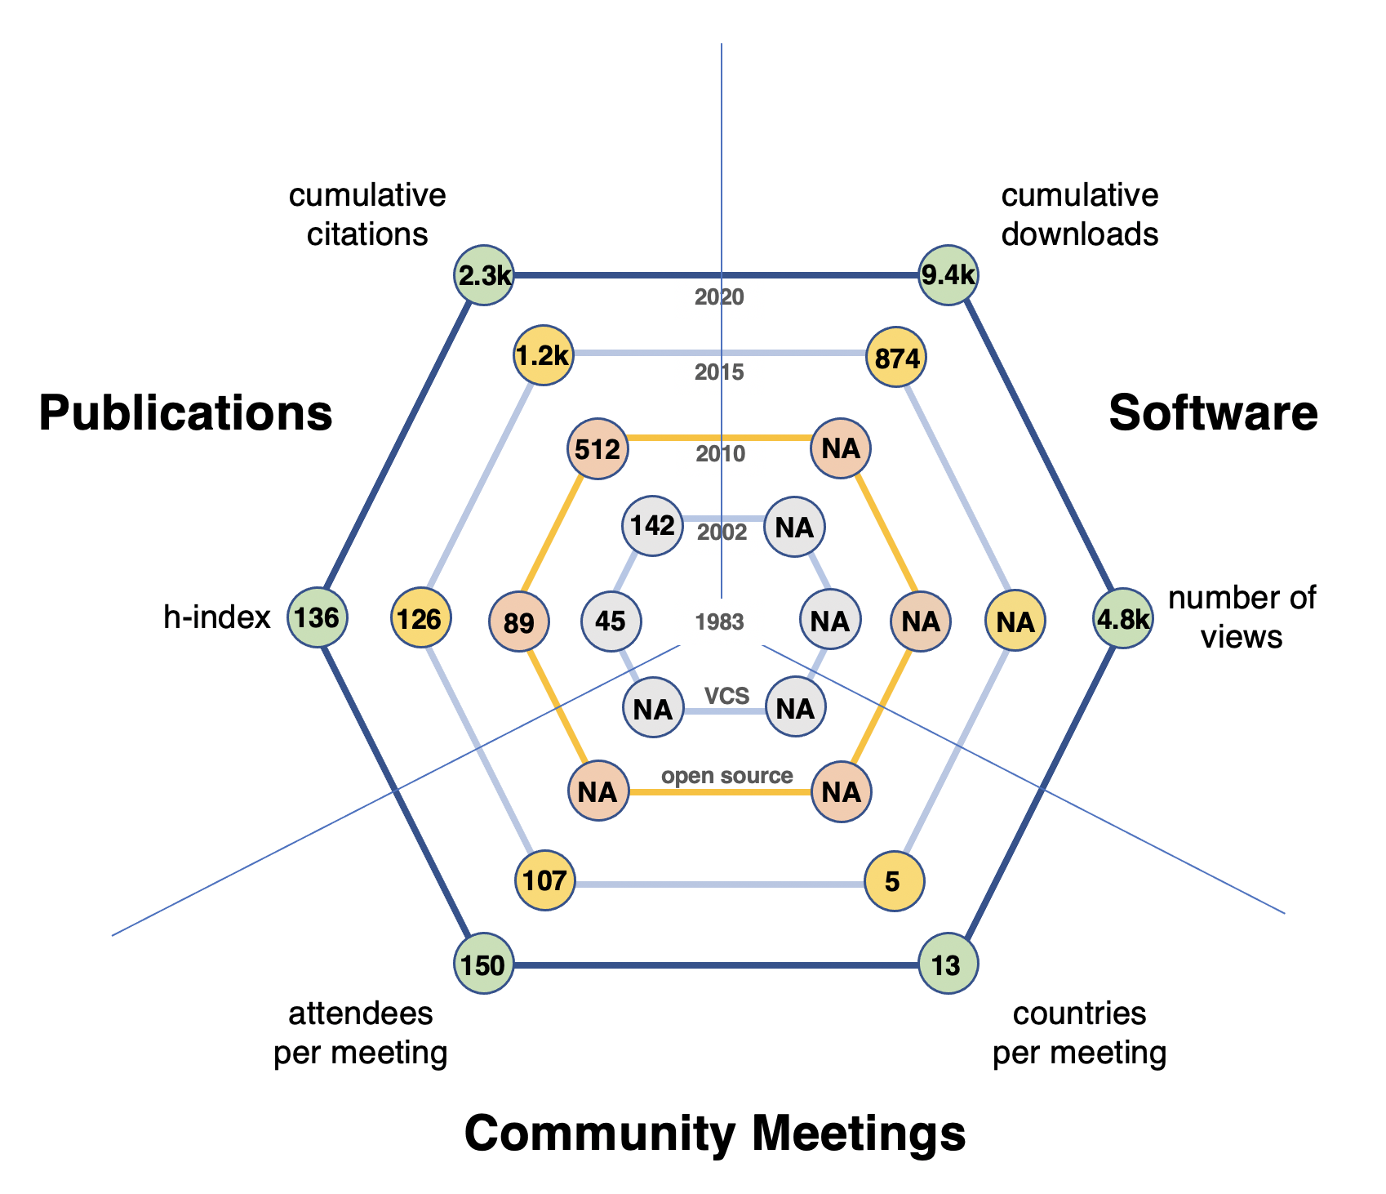
The power of open-source in a community modeling system
Being fully open-source == big impact and high transparency
Promotes interoperability across agencies and programs
We follow FAIR guiding principles and participate in guiding the development of standards for reproducibility in modeling software via the Open Modeling Foundation
We are able to utilize and contribute to state-of-the-science software from other communities (e.g., CSDMS)

Slide 9
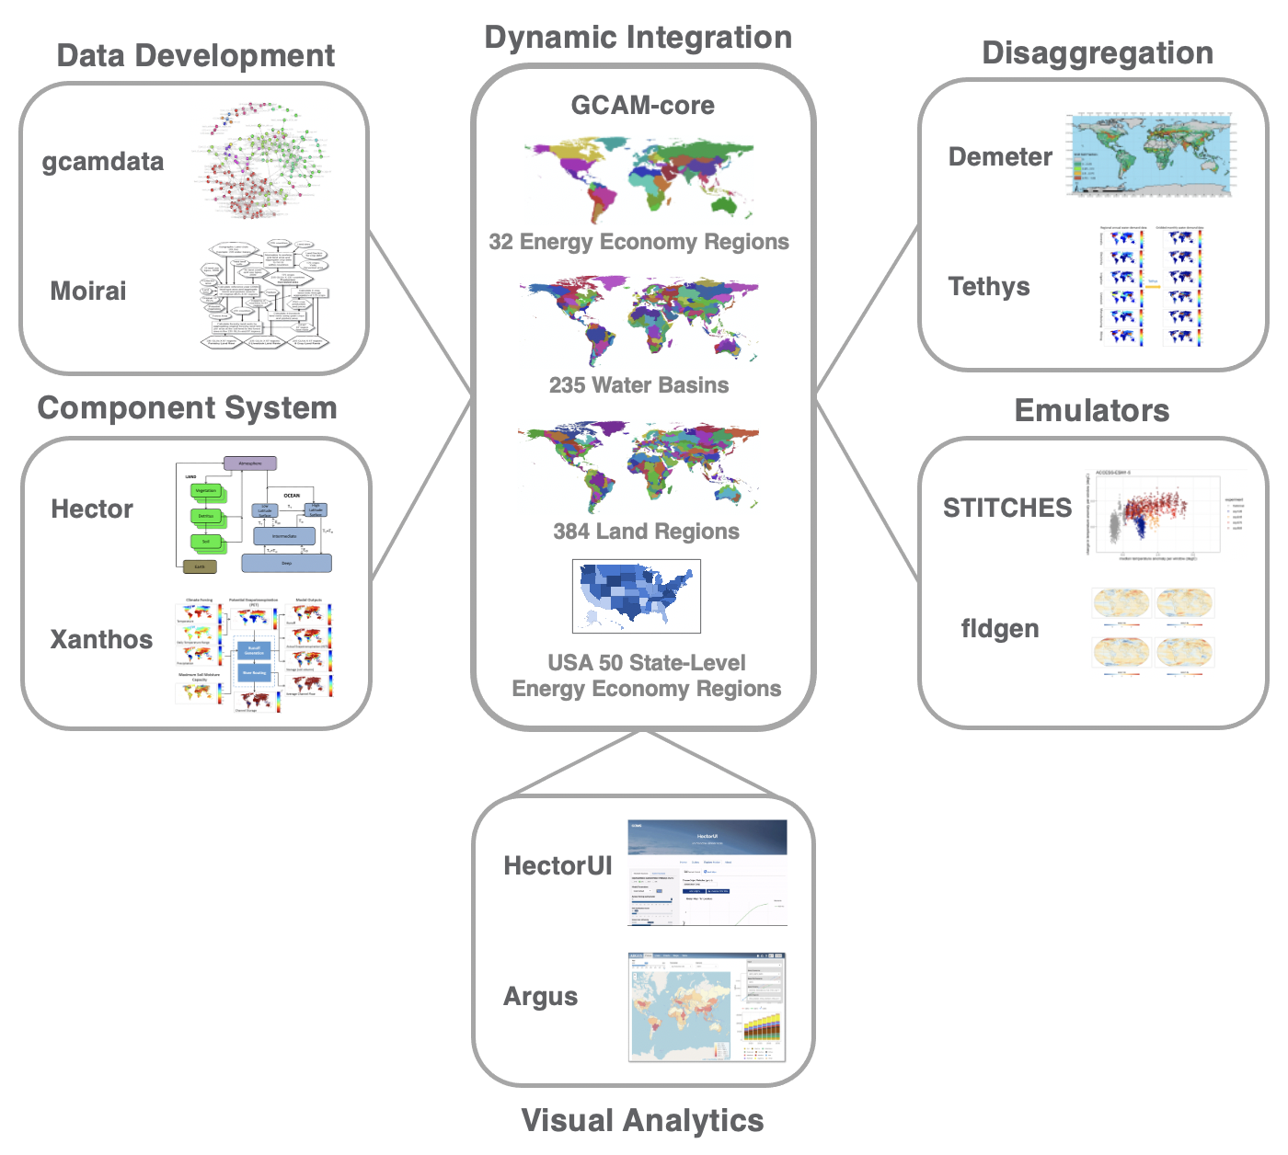
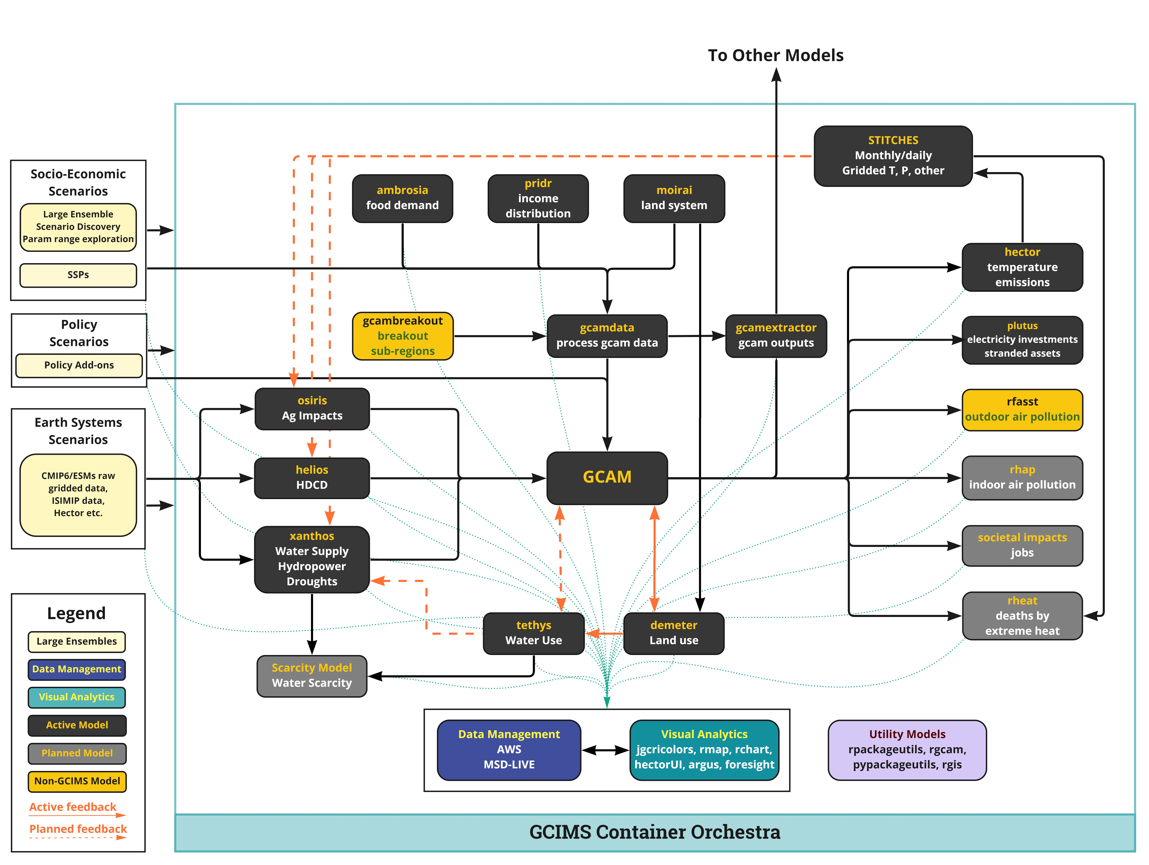
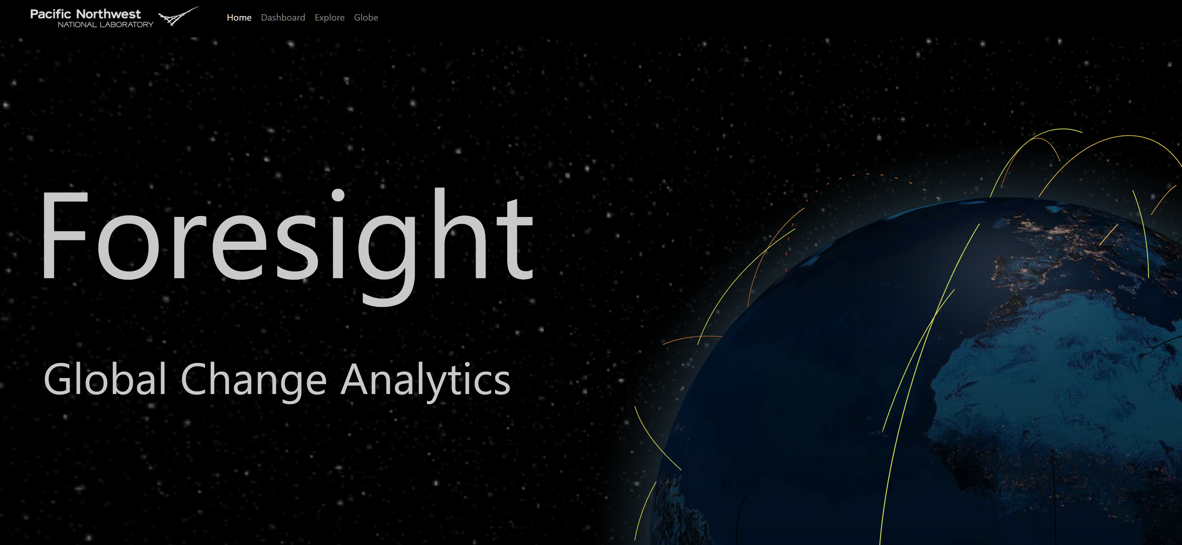
EFC Modeling Software and Integration
Snapshot of GCIMS classes of modeling software
Snapshot of GCIMS integrated modeling

Slide 10
GCIMS EFC Software Team
GCAM
Pralit Patel (lead)
Ellie Lochner
Marshall Wise
Matthew Binsted
Gokul Iyer
Sonny Kim
Page Kyle
So many more…
Xanthos
Mengqi Zhao (lead)
Tom Wild
Guta Abeshu
Neal Graham
Hassan Niazi
Stitches
Abigail Snyder
Kalyn Dorheim
Claudia Tebaldi
GCIMS PI and coordinator
Marshall Wise (PI)
Kali Jokerst (coordinator)
GCIMS EFC lead
Chris Vernon
Ambrosia
Kanishka Narayan (lead)
Stephanie Waldhoff
Jae Edmonds
Tethys
Chris Vernon
Hassan Niazi
Lots more in active development by our team…
GLORY, rgcam, gcam_reader, rgis, rmap, gcamland, many more!
Hector
Ben Bond-Lamberty (co-lead)
Kalyn Dorheim (co-lead)
Demeter
Kanishka Narayan (lead)
Plutus
Mengqi Zhao (lead)
Deployment & Integration
Pralit Patel
Chris Vernon
Sash Lambda
Helios
Mengqi Zhao (lead)
Also active training and resource development…
Yang Qiu for GCAM Users Group; many involved
Taryn Waite for training resource development; many others involved
Much more!
HectorUI
Stephanie Pennington (lead)
Ciara Donegan
gcamextractor
Mengqi Zhao (lead)
Moirai
Kanishka Narayan (lead)
Alan Di Vittorio
foresight
Ben Knight
Mengqi Zhao
Taryn Waite
Hassan Niazi
Osiris
Hamza Ahsan(lead)
Abigail Snyder
BASD
Noah Prime(lead)
Claudia Tebaldi
gcamdata
Pralit Patel
Steve Smith
Major institutional impact…
Jae Edmonds, Sonny Kim, and Page Kyle
Matilda
Joe Brown (lead)

Slide 11
Some Recent News
Hector v3 and beyond!
New land-atmosphere carbon exchange constraints
Carbon tracking capabilities
New radiative forcing coefficients (Dorheim et al., in review)
Much more
Matilda released and published (Brown et al., 2024)
Provides a method to build parameter sets from user-provided prior knowledge, run Hector iteratively to produce perturbed parameter ensembles, weight those ensemble performance against observed data, and ultimately compute probabilistic projections for climate variables of interest

Slide 12
Some Recent News
STITCHES (climate model output varied scenario generator)
New software publication (Snyder et al., 2024)
Optimized workflows for the stitching algorithm
Much more
BASD released (bias adjustment and statistical downscaling of climate variables)
Downscale simulated model outcomes at a desired resolution
Tools for visualization, cross validation, and much more
Provides a bridge for emulated climate data use in Xanthos and other global hydrologic models

Slide 13
Some Recent News
Xanthos (global hydrologic modeling framework)
Detailed representation of hydropower reservoir operations (Abeshu et al., 2023)
GLORY released (global reservoir yield model)
Optimizes water yield for a given reservoir storage capacity while estimating the economic value of water supply for global river basins
Zhao et al. (accepted and in press with GMD)
Integrated with Xanthos and GCAM via gcamwrapper to provide new surface water supply curves per time step via highly coordinated feedback strategy
Superwell released (Niazi et al., 2024)
Provides the economic impacts of nonrenewable groundwater consumption for GCAM

Slide 14
Some Recent News
gcamfaostat released (Zhao et al., 2024)
Prepares, processes, and synthesizes complex agroeconomic data for use in the agriculture and land use (AgLU) sector of GCAM
Provides a transparent and reproducible pipeline for data development
Moirai (builds harmonized AgLU data inputs to GCAM)
Extended by Di Vittorio and Narayan to produce a base year land use and land cover spatial map for Demeter (LULCC downscaling package)
Di Vittorio et al. (in prep) improved the representation of biodiversity in GCAM by building off of previous work to provide variable protected land scaling in Moirai, offering varying biodiversity value for protected land
Updated terrestrial carbon densities for each land use designation (Narayan et al., in review)

Slide 15
Some Recent News
Demeter
Lots going on here but I’ll let Kanishka tell you all about things in the tutorial that follows this presentation!

Slide 16
BACKUP

Slide 17
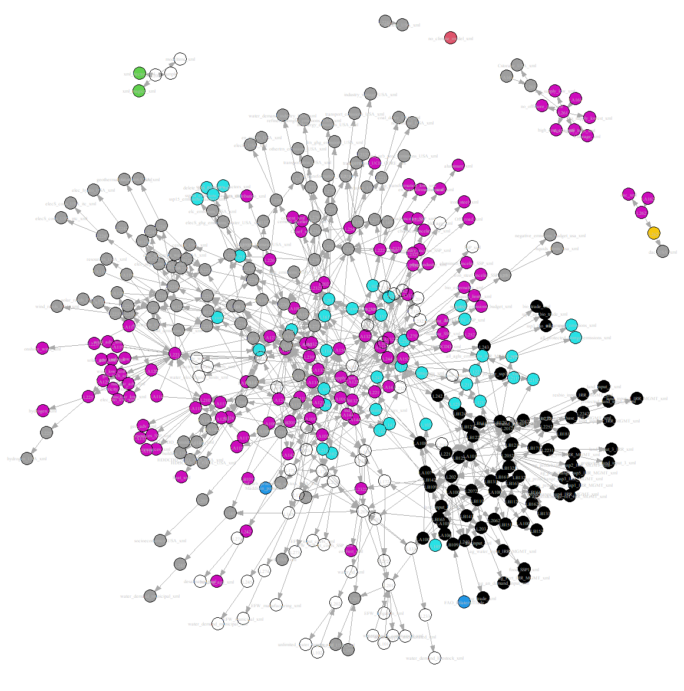
gcamdata: how it works
CAPABILITY LEAD: Ellie Lochner
There are nearly 1,000 input data files, primarily in csv form, which contain data from other sources, such as IEA, EIA, EPA, etc. as well as input assumptions for GCAM
gcamdata consists of hundreds of “chunks”, which are R files that contain a function to process raw input data and intermediate data products
The “driver” is a function that locates all the available chunks, and queries them for their dependencies and outputs, which allows for the construction of a full data-dependency graph
Driver then goes through the graph, running chunks with available dependencies and saving outputs to a data store, and/or as output csv and XML files

Slide 18
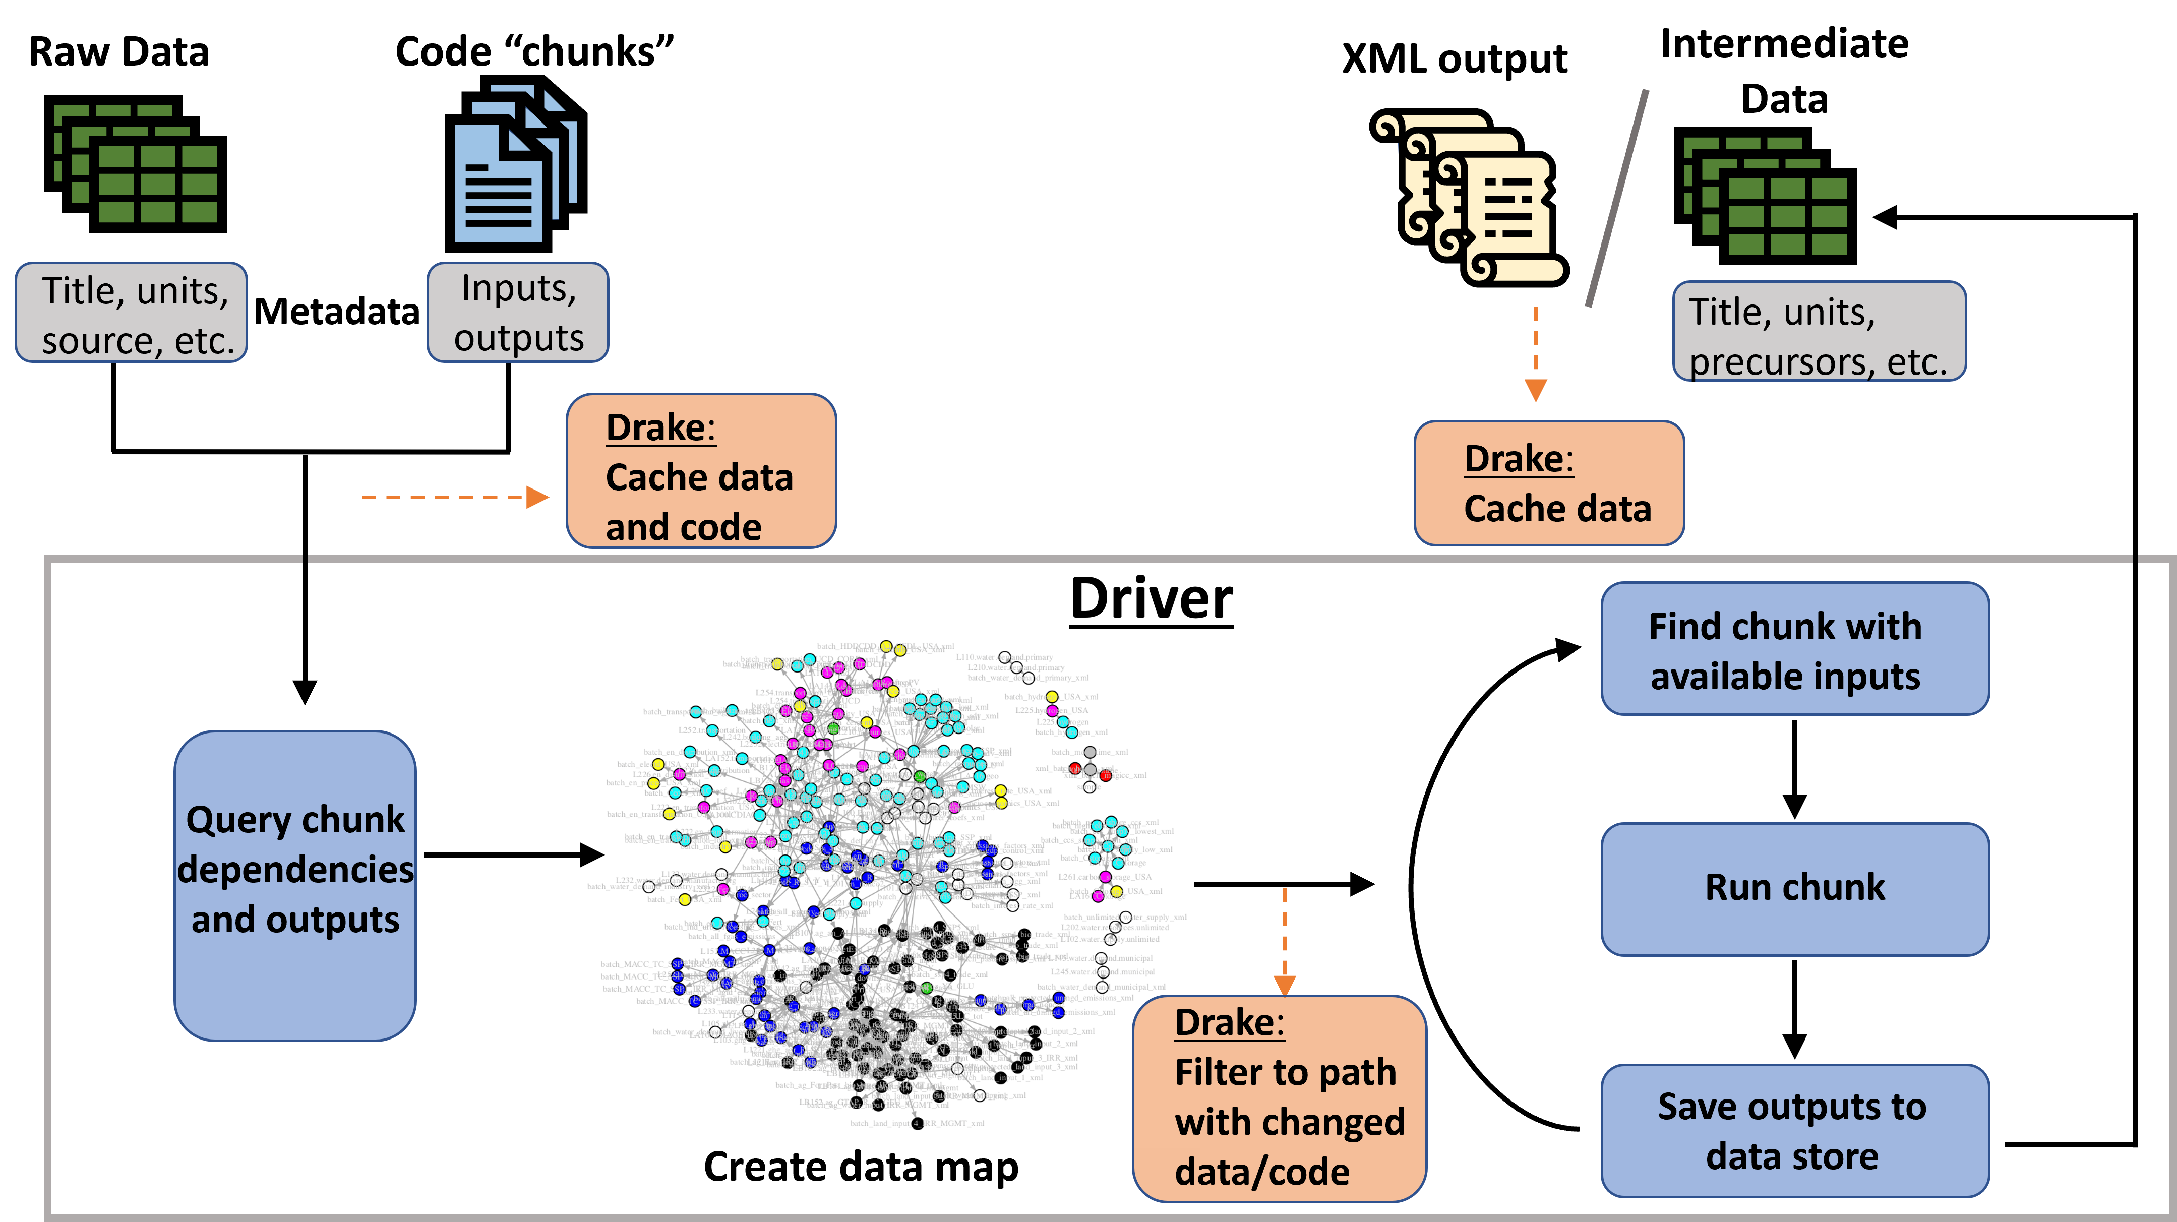
gcamdata workflow
CAPABILITY LEAD: Ellie Lochner

Slide 19
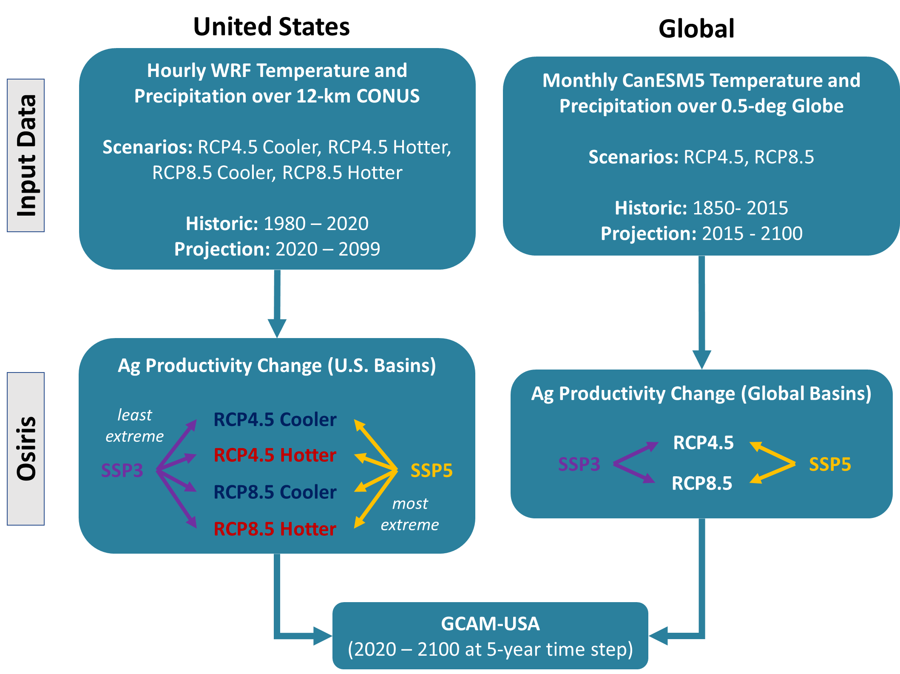
Osiris: agricultural yield impacts
CAPABILITY LEAD: Hamza Ahsan
Osiris is a modular data pipeline that transforms gridded crop yield data into agricultural yield impacts for GCAM commodities.
Key features of this package are:
Processing of CMIP style data to relevant growing season metrics allows users to explore alternative growing season decisions
The use of best available emulators means users are not restricted to specific scenarios and can still have confidence in projections
The modular design allows for updates in a more efficient fashion as new tools (updated emulators, etc.) become available
Designed for interoperability with the GCAM data system without adding additional large data files
Fig. 1. Climate data reflecting a range of Representative Concentration Pathways (RCPs) and climate model uncertainty (where “hotter” and “cooler” represent diversity in climate sensitivity of the CMIP6 GCMs) are combined with Shared Socioeconomic Pathways (SSPs) to generate agricultural productivity change inputs for GCAM-USA.
19

Slide 20
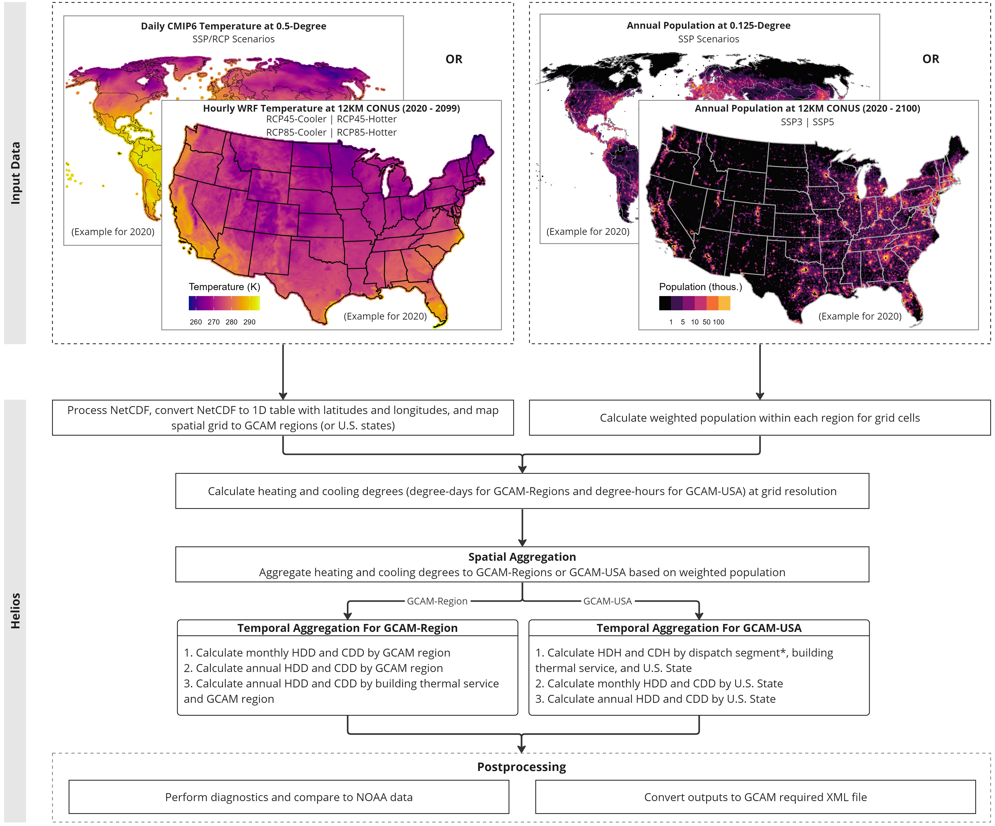
CAPABILITY LEAD: Mengqi Zhao
Helios: heating and cooling degree hours or days
Overview
Helios is an R package that calculates population-weighted heating and cooling degree-hours and degree-days for GCAM and GCAM-USA.
Heating and cooling degrees can imply the building energy demand.
Inputs
Temperature (CMIP, WRF)
Population (same resolution with the temperature data)
Outputs
For USA States
For Global Regions

Slide 21
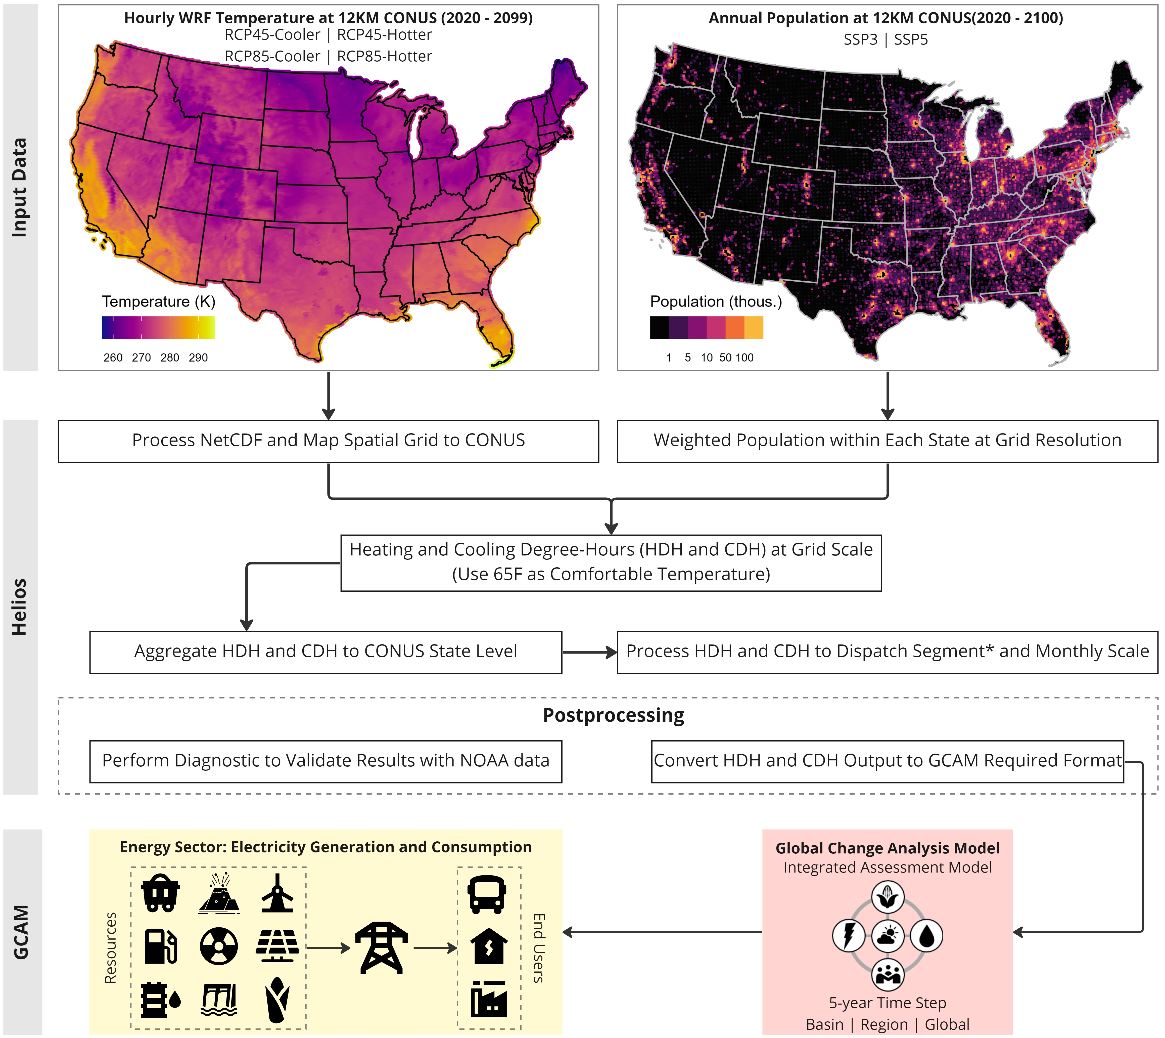
Helios: Design and Method
CAPABILITY LEAD: Mengqi Zhao
Process climate and population data (NetCDF) and convert to 1D tabular table
WRF-TGW
ISIMIP-CMIP
read_hdcd and read_population will process the climate and population data to tables with latitudes and longitudes.
hdcd: calculate heating and cooling degrees in different formats.
diagnostics: Provide diagnostic plots and validate with observations if available
save_xml: save to GCAM required XML file

Slide 22
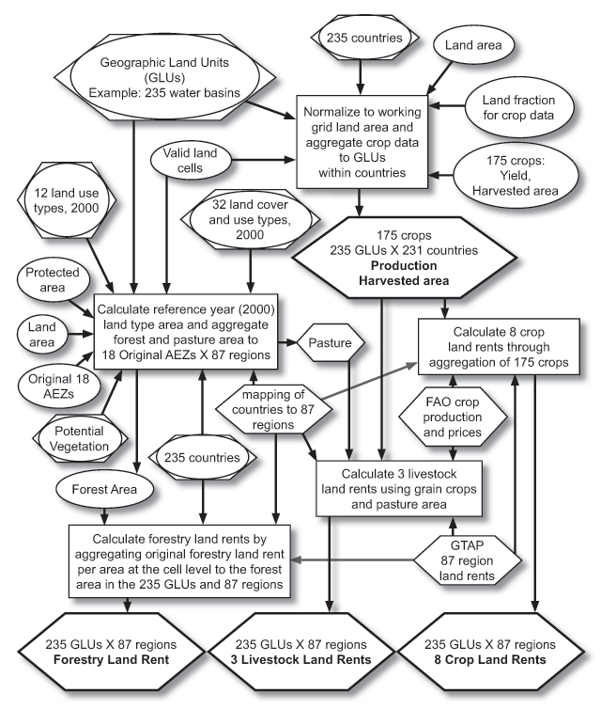

Moirai: the land data system for GCAM
CAPABILITY LEADS: Kanishka Narayan & Alan Di Vittorio
Diagram showing inputs to and outputs of moirai
A land data system that combines raster inputs and generates spatially referenced tabular outputs.
moirai currently generates the inputs for the agriculture and land use model for the Global Change Analysis Model (GCAM)
moirai amalgamates disparate spatial and tabular data to generate harmonized spatial products at a 5 arcmin resolution. These spatial products are then aggregated to generate tabular outputs for 235 global water basins.
Can generate outputs dynamically for any given regional mapping.
Written in C with diagnostics in R.
Di Vittorio, A., Vernon, C.R. and Shu, S., 2020. Moirai Version 3: A Data Processing System to Generate Recent Historical Land Inputs for Global Modeling Applications at Various Scales. Journal of Open Research Software, 8(PNNL-SA-142149).

Slide 23
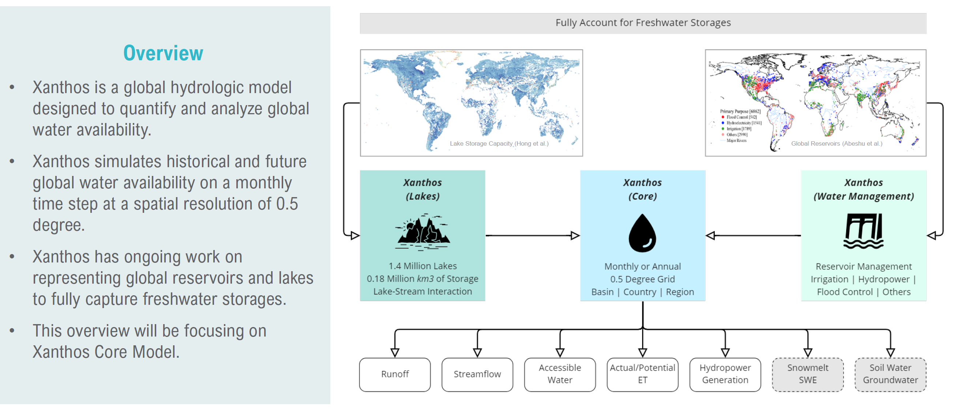
Xanthos: overview
CAPABILITY LEAD: Mengqi Zhao

Slide 24
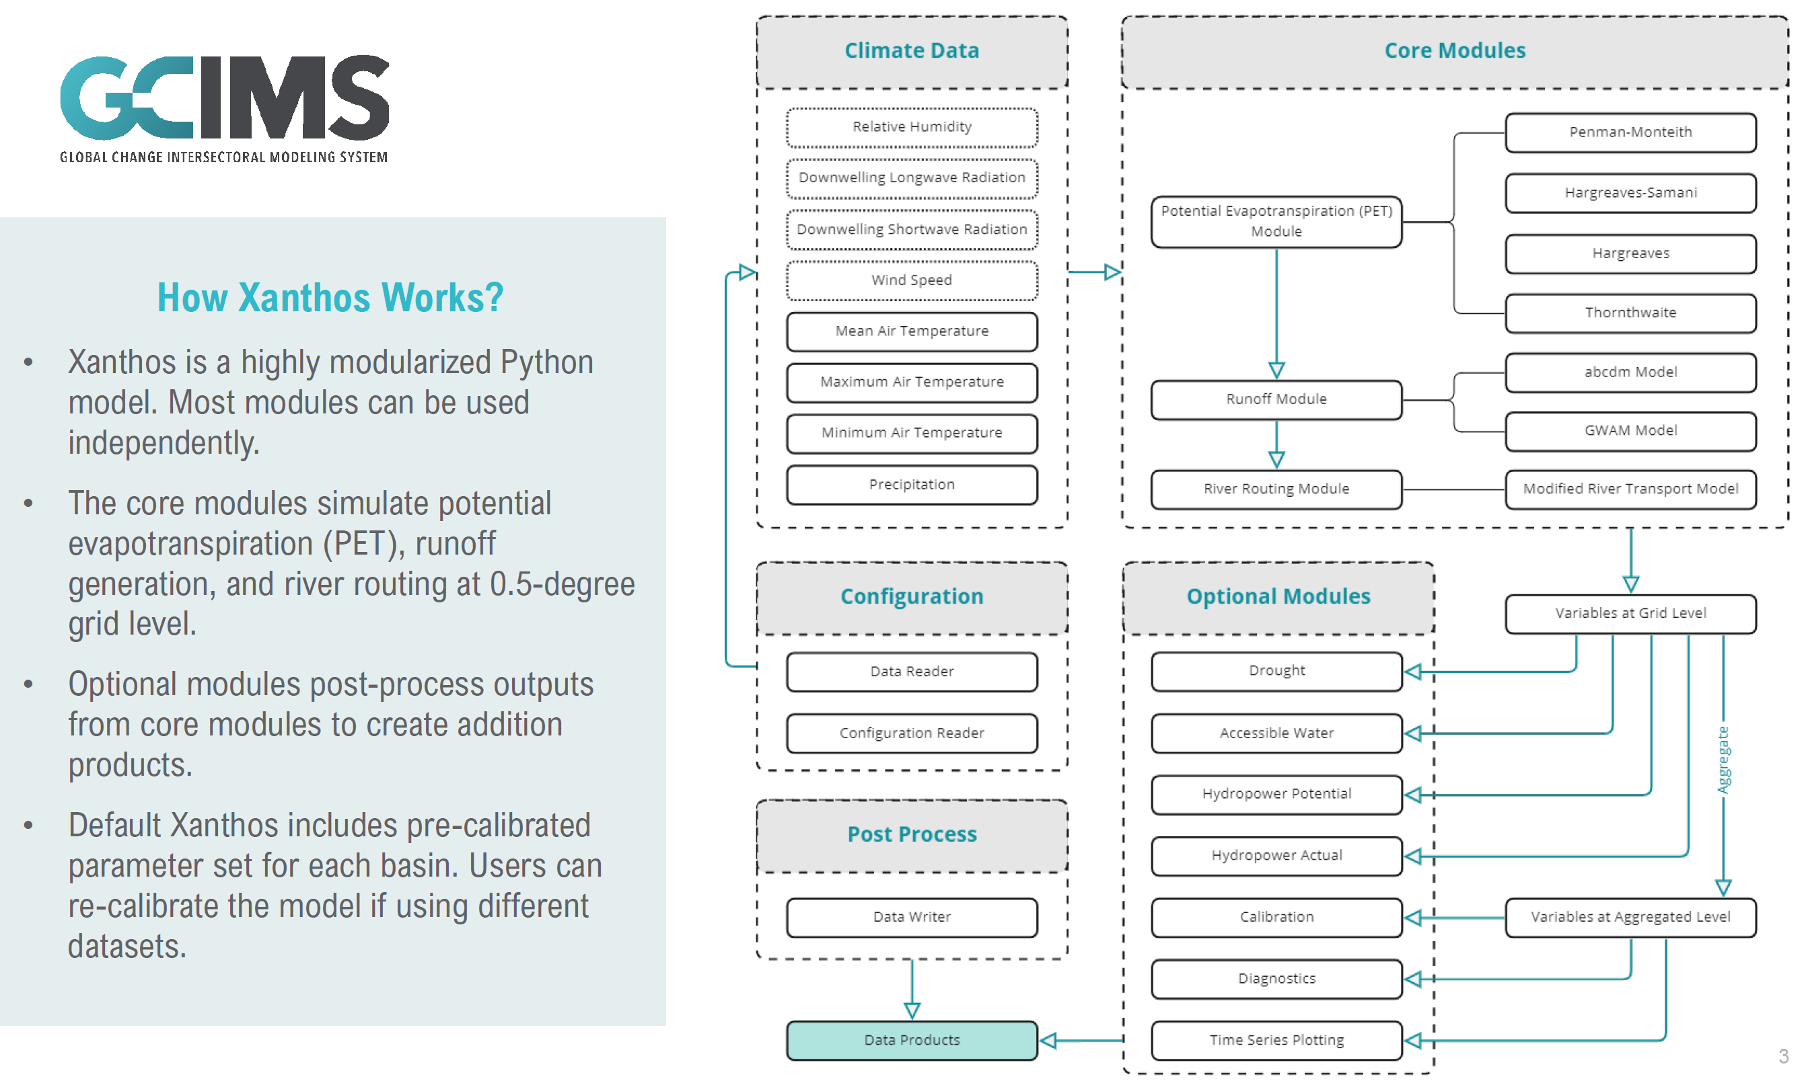
CAPABILITY LEAD: Mengqi Zhao

Slide 25
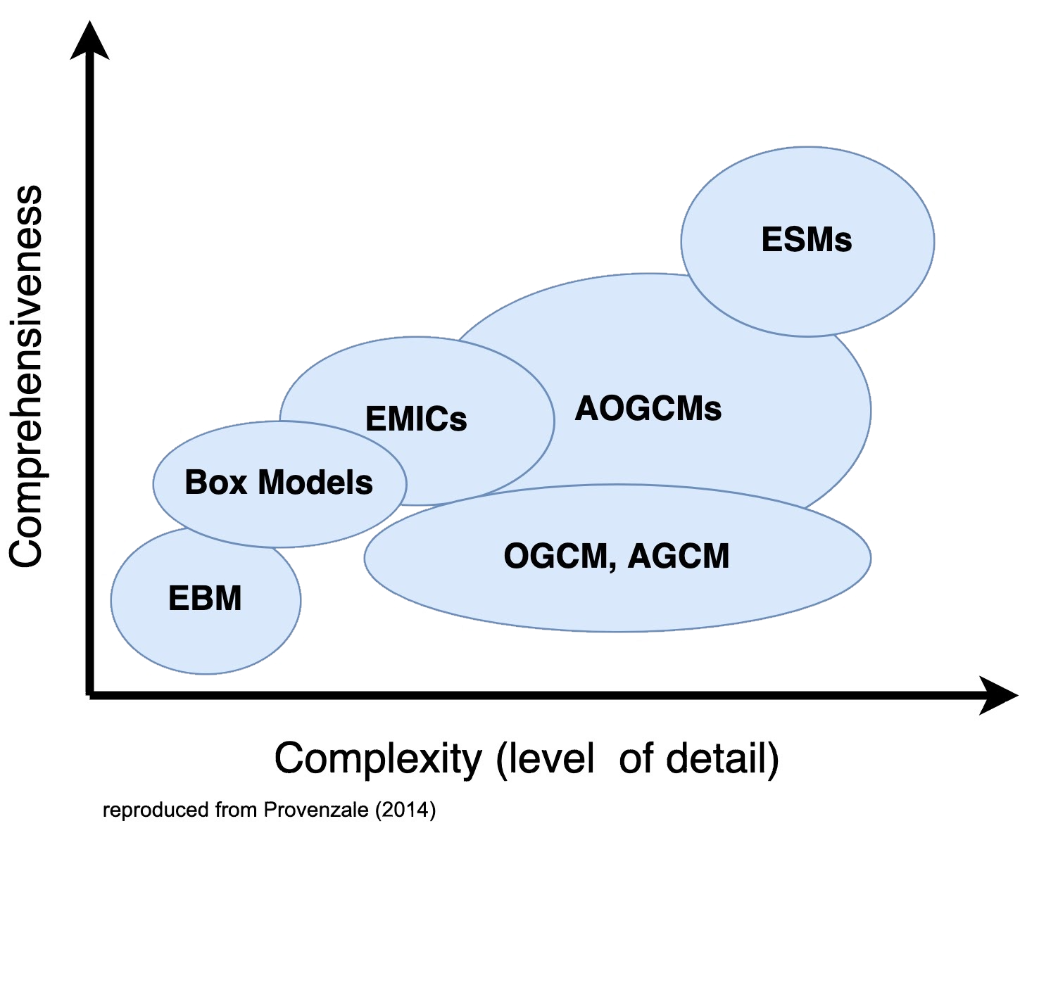
Hector is a simple climate model
CAPABILITY LEADS: Kalyn Dorheim & Ben Bond-Lamberty
Simplified representations of critical Earth system dynamics
Computationally efficient
Wide range of applications
Coupling exercise
Large ensembles
Emulation
Scenarios
https://www.scisnack.com/2015/04/13/in-the-climate-model-jungle/
https://www.scisnack.com/2015/04/13/in-the-climate-model-jungle/
Notes:
Climate models are diverse, span a range of complexity and comprehensiveness in their represenatiuons of the Earth system
ESM
High temperoal and spatial resolution, capable to modeling a large to fine scale atmoepher, ocean dynmics include ocean eddies
Comes at a cost of computation time
Next
At the other end of the spektrum there are group of models highgleded here SCM
Intinal simmplifed repslations of earth system dynamics (lower tmperatoral and spatial reoaltinos) computationally efficient
Wide range of applications
Hector is on of the more complex simplified climate model because of the number because it is ability to model several variables via is coupled carbon and climate model sytem

Slide 26
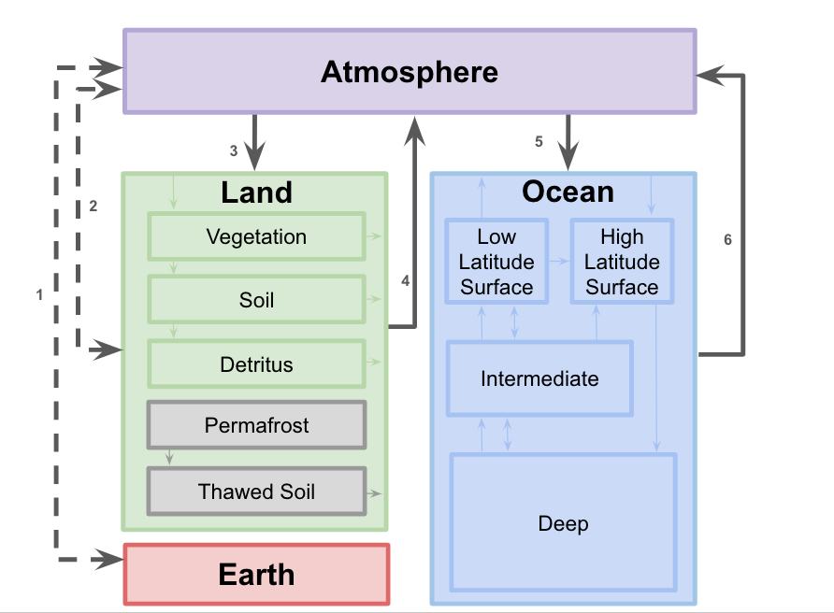
Hector: brief intro
CAPABILITY LEADS: Kalyn Dorheim & Ben Bond-Lamberty
Modular and open source
Multiple ways to access/use
Training will cover HectorUI & Rhector
Well mixed atmosphere
Terrestrial carbon cycle
Biomes in lieu of spatial resolution
Ocean carbon cycle
Active surface ocean chemistry
Freestanding & coupled with GCAM
Freestanding & coupled with GCAM
Carbon & energy fluxes
Terrestrial carbon cycle
Biomes in lieu of spatial resolution
Active surface ocean chemistry
Freestanding or coupled to GCAM
Hector’s Carbon Cycle
Notes:
Since 2015 Hector was designed to be be a fexlible modular, open source model acciessible to the community provide 3 different ways to run stand alone Hector 2 of which
Hector is a simple climate model
Quick run time fraction of a second
Climate – carbon cycle
Carbon cycle illustrated here is 4 box
Atmos
Land
Ocean
Earth (fossil fuel pool)
Atmos – well mixed
land terresital carbon models pimrary production and respiration from 3 pools (veg, soil, detiruts) can be configured to run with an atrbiraty number of biomes and a permafrost moduled
Ocean carbon cycle 4 pools actively solves the inofanice cabron cycle in the the ocean surface
Hector can be run as either a free standing model (emissions provided from external sources IAM, scenario database) & is it coupled with GCAM

Slide 27
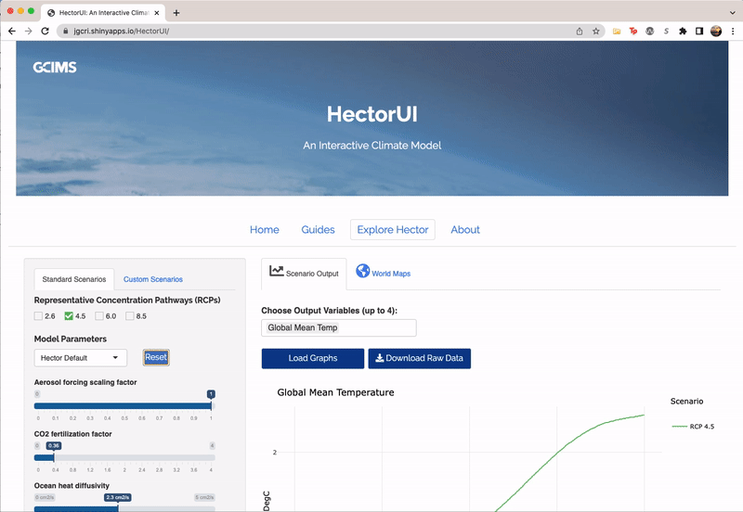
Welcome to HectorUI, the interactive version of Hector
CAPABILITY LEAD: Stephanie Pennington
Hector runs in real time
https://jgcri.shinyapps.io/HectorUI/

Slide 28
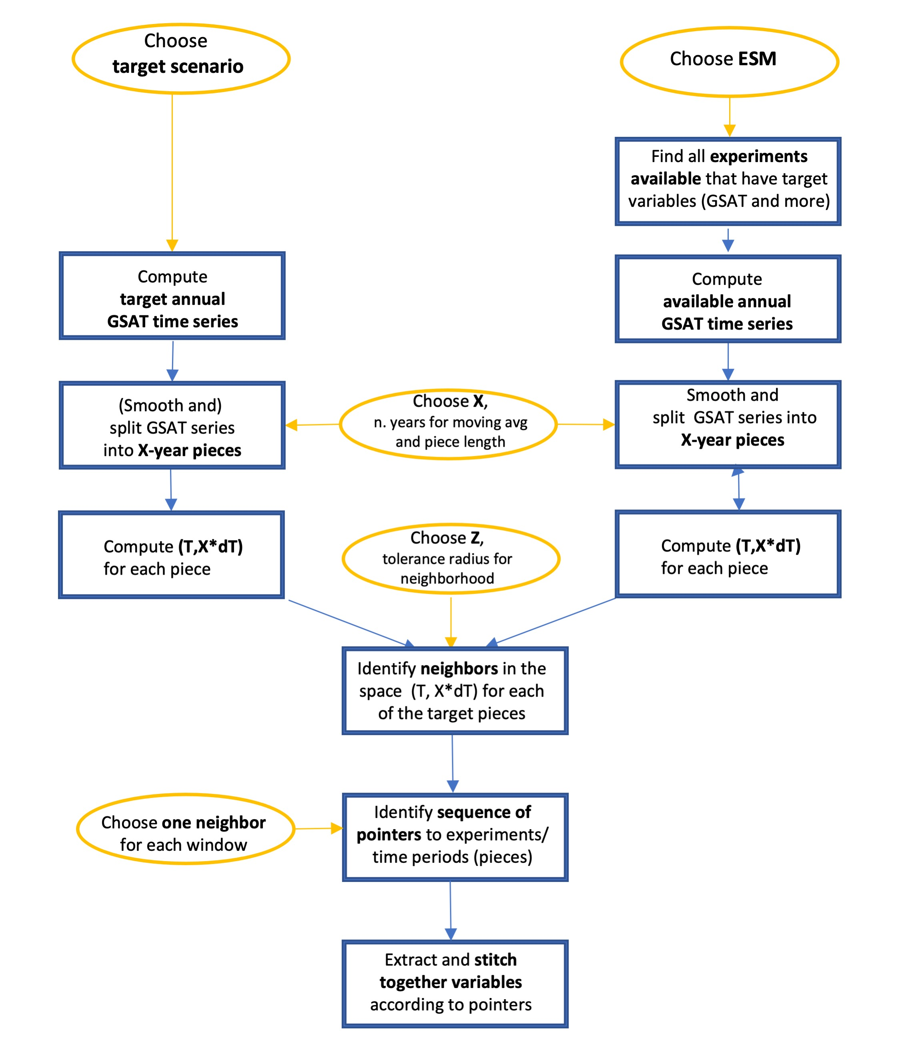
CAPABILITY LEADS: Claudia Tebaldi, Abigail Snyder, Kalyn Dorheim
STITCHES: comprehensive ESM output emulator
STITCHES is a comprehensive emulator of Earth System Model output for impact analyses
STITCHES uses a top-down approach:
We take existing output and we intelligently recombine pieces of it into new instances by stitching them together on the basis of a target global average temperature (GSAT) trajectory. Thus, the statistical characteristics of ESM output remain intact by construction along a new scenario.

Slide 29
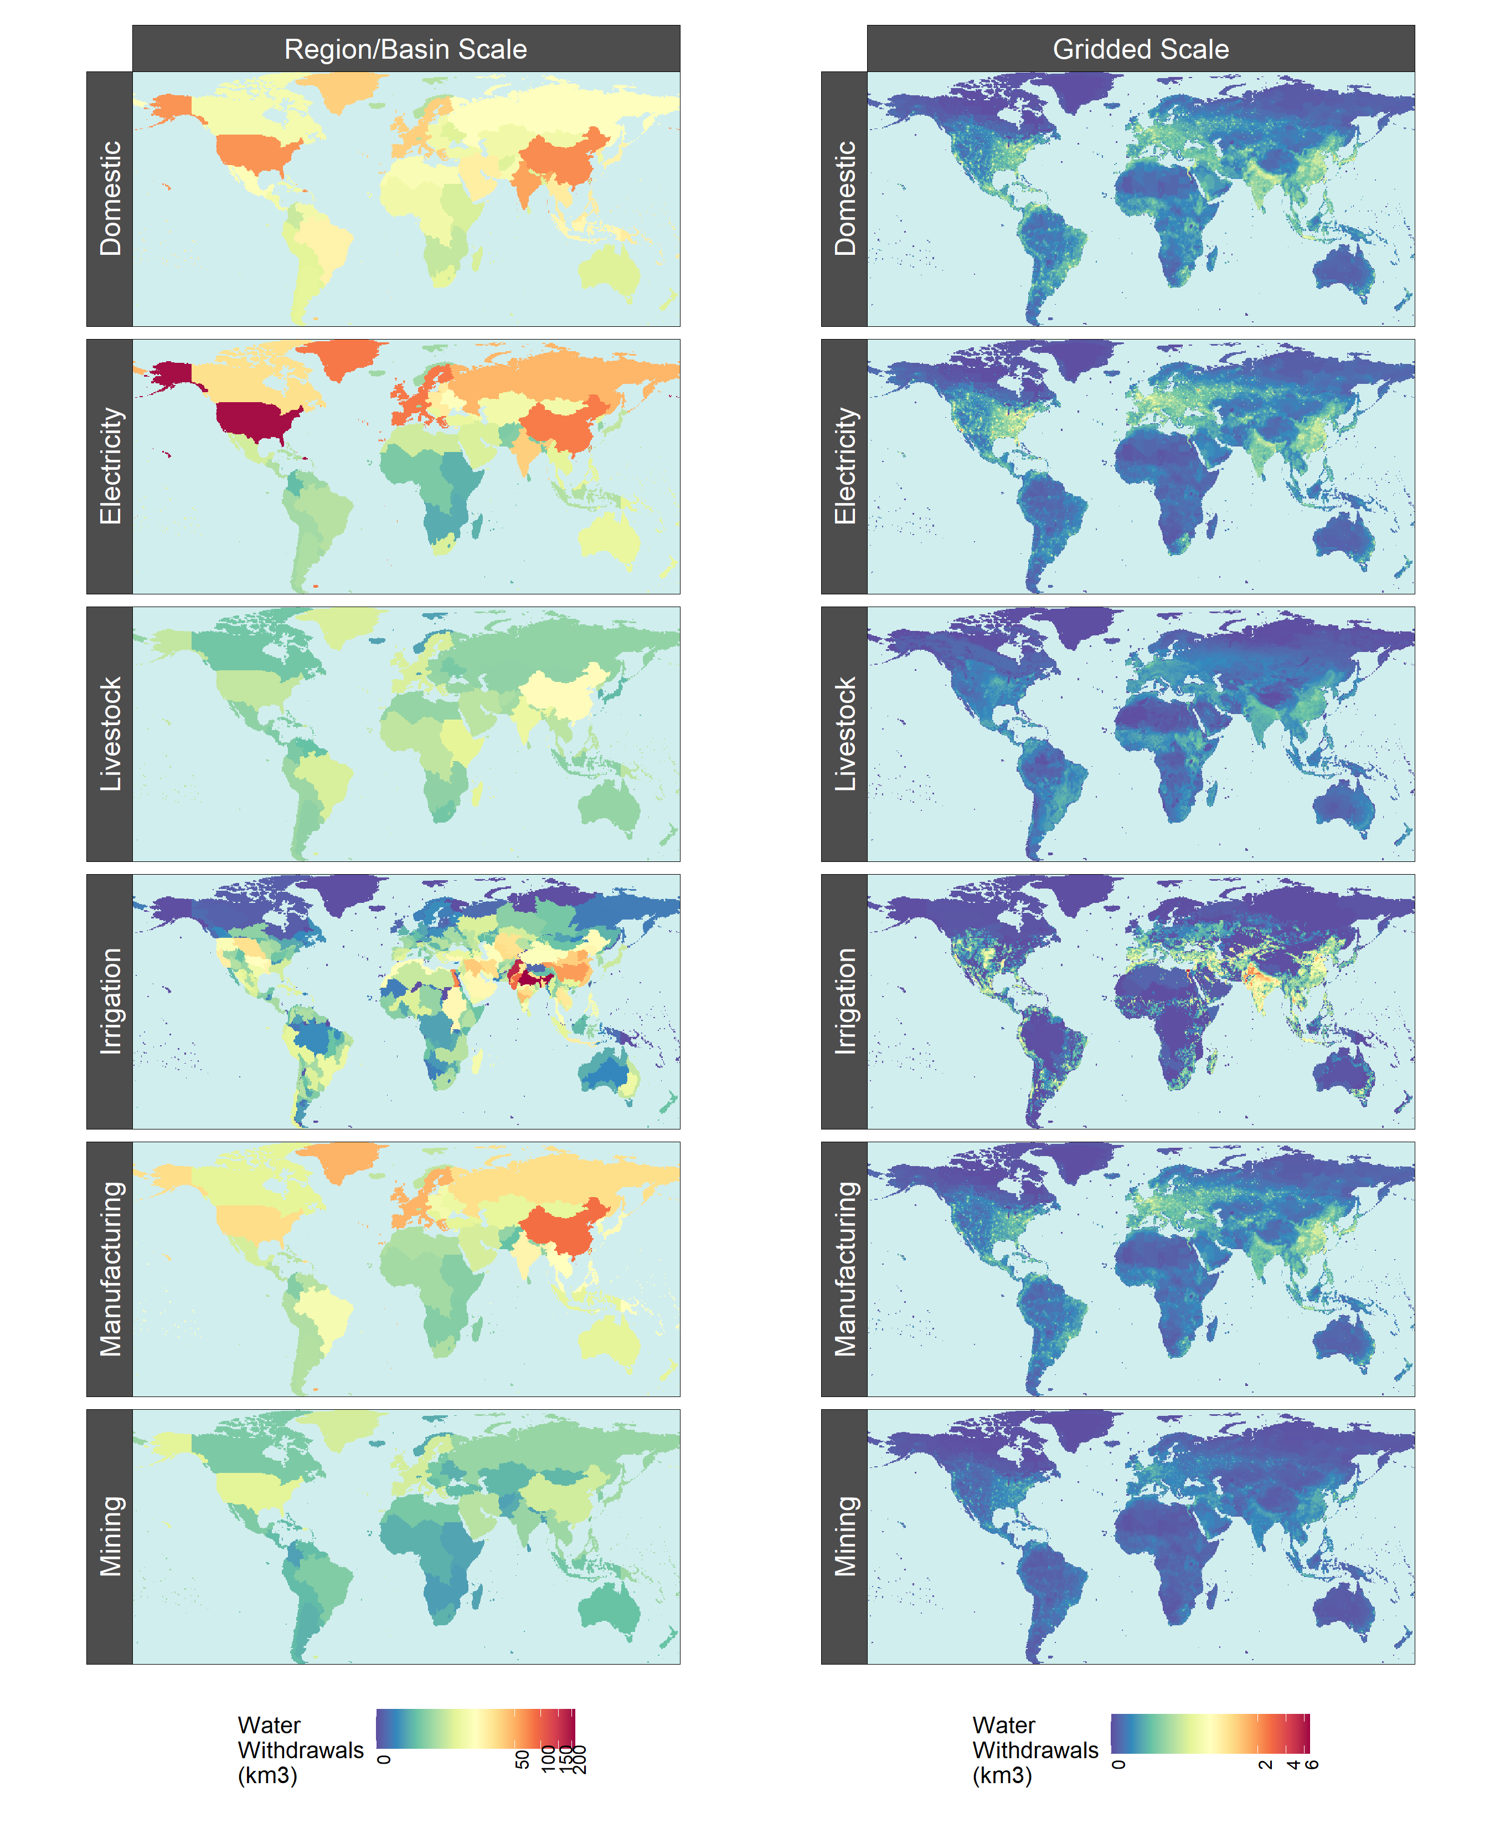
What is Tethys?
CAPABILITY LEAD: Isaac Thompson
Regional, Annual
Gridded, Monthly
Tethys
Tethys is a spatiotemporal downscaling model for global water demand
It disaggregates GCAM water withdrawals and consumption across 6 sectors

Slide 30
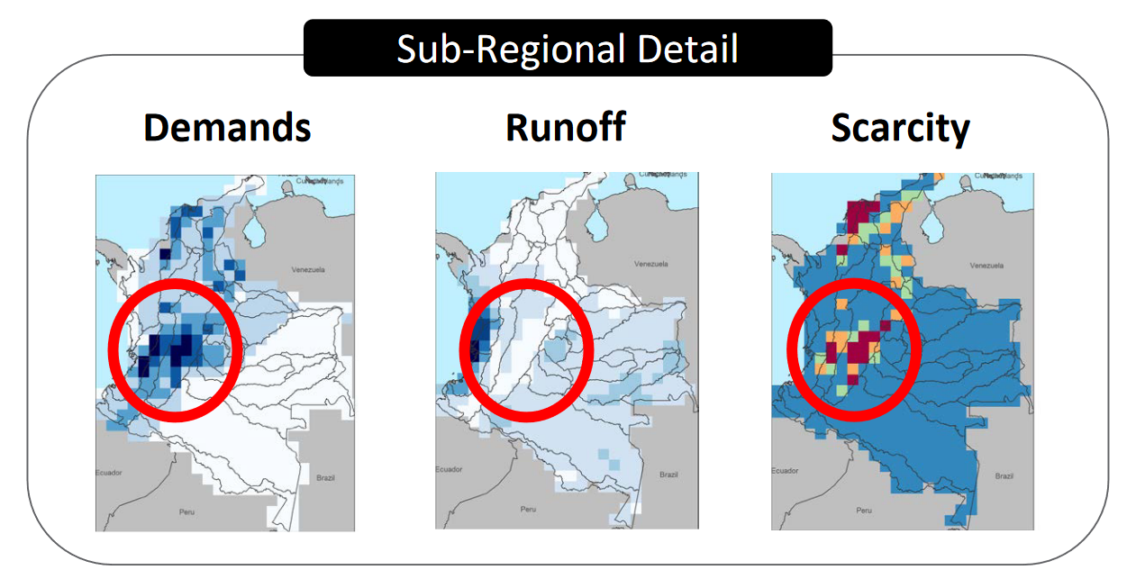
Tethys: Why Downscale?
CAPABILITY LEAD: Isaac Thompson
Facilitate coupling with gridded hydrology models
Localized water demand projections are needed to understand water scarcity

Slide 31
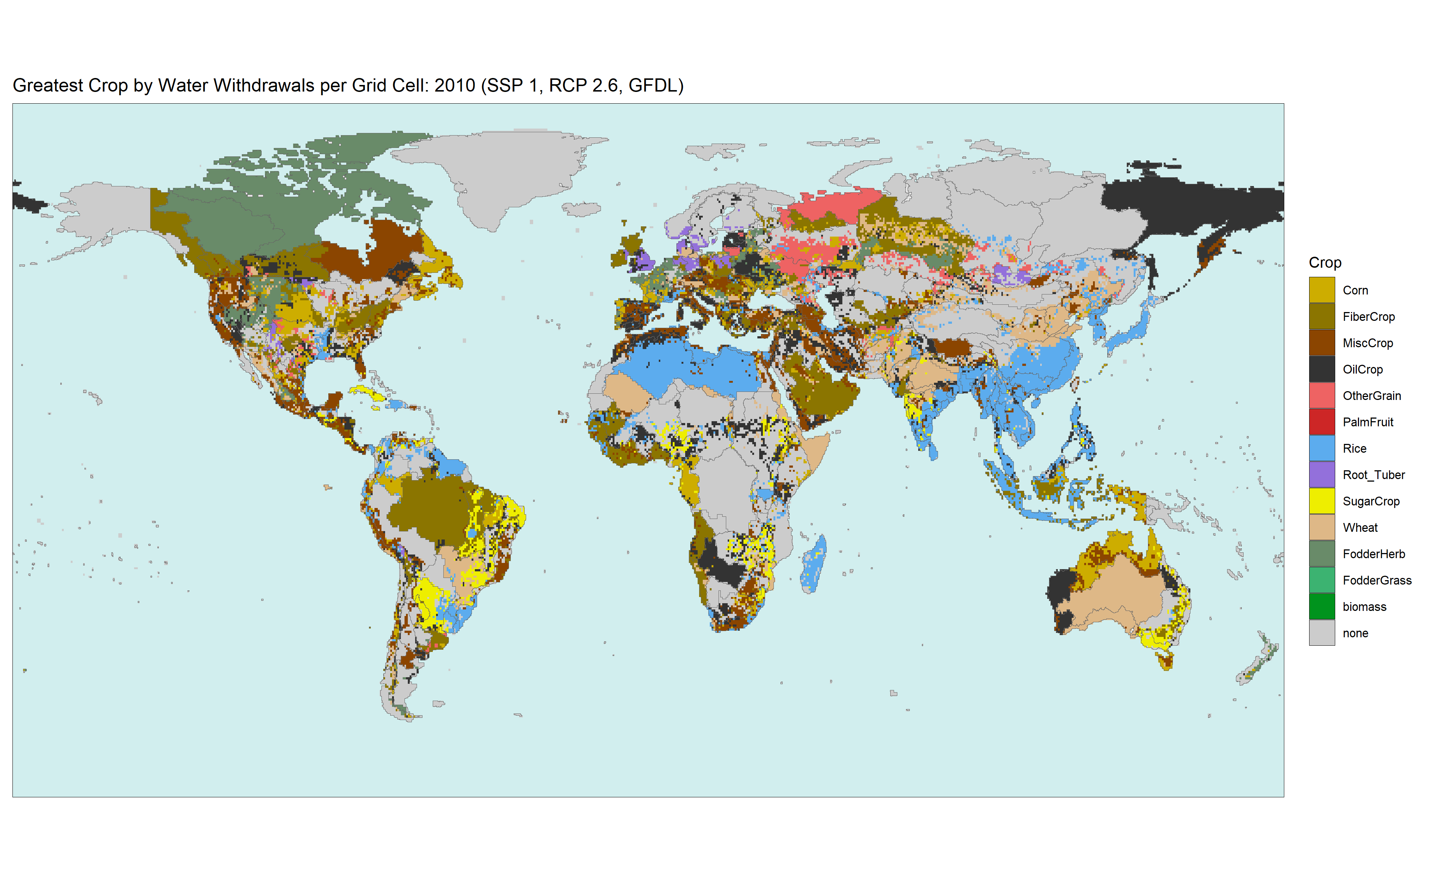
Coupling With Demeter
Demeter spatially disaggregates GCAM land-use and land-cover change to produce gridded maps
Tethys uses these outputs as proxies for irrigation of 13 crop types

Slide 32
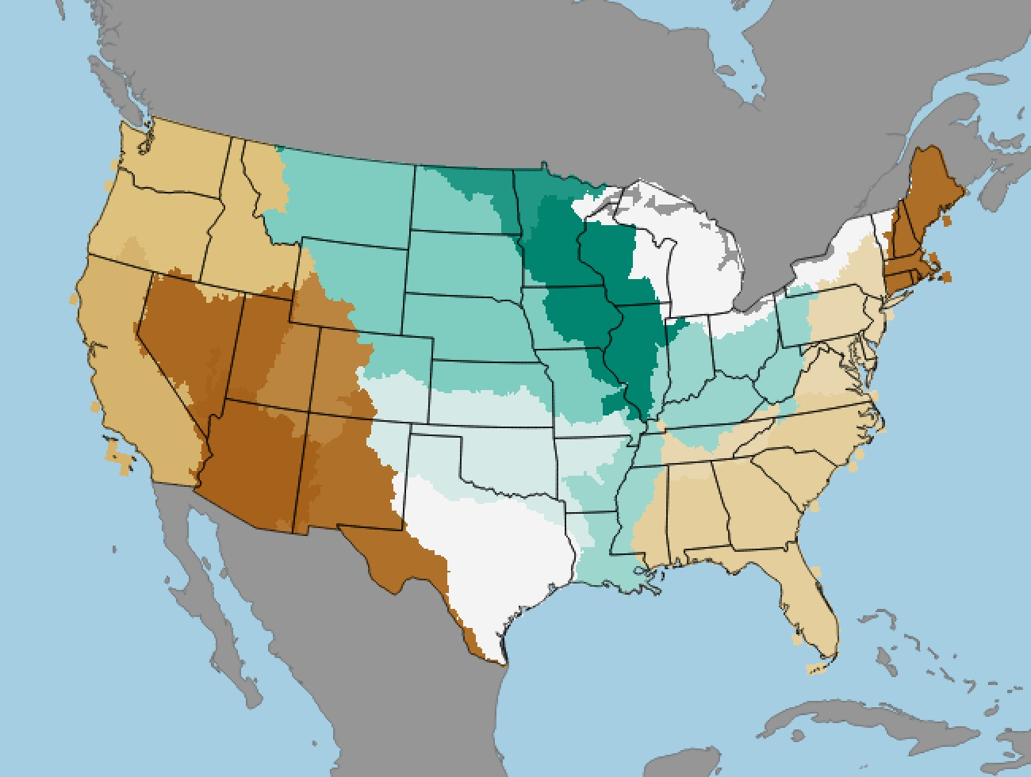
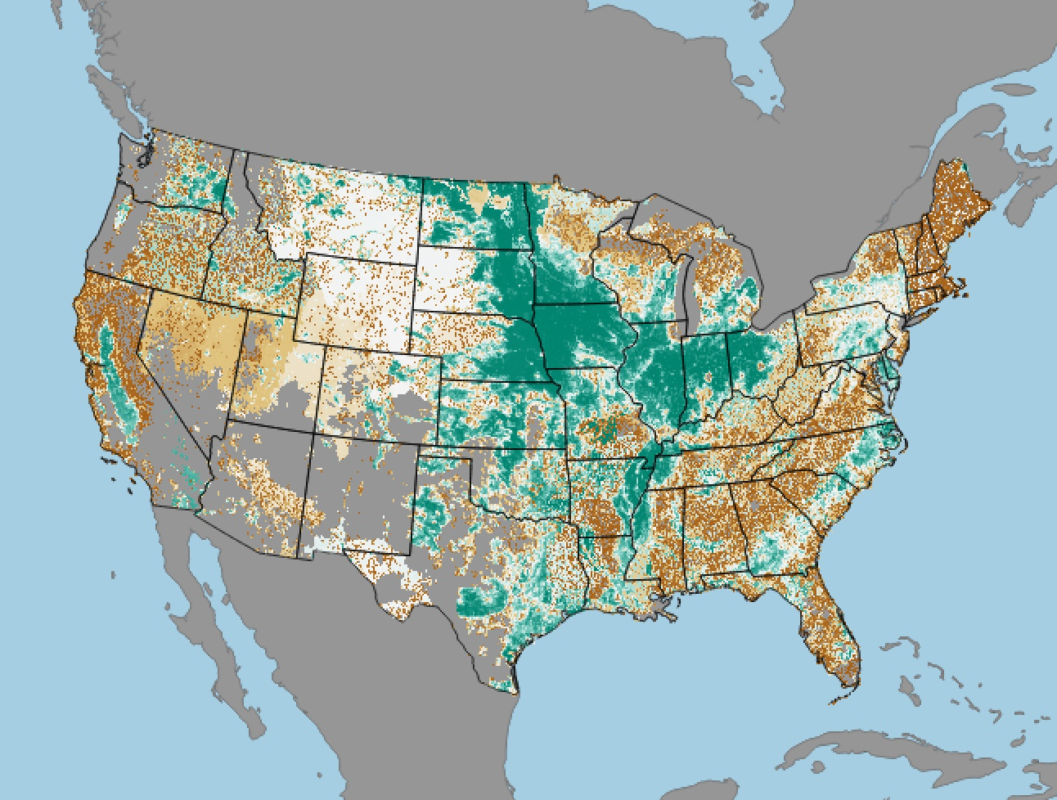
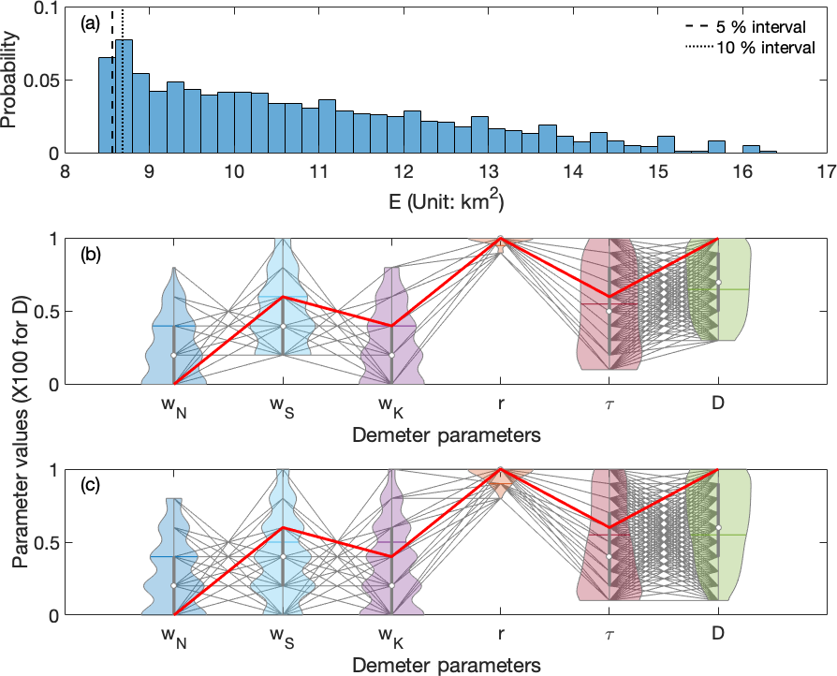
Demeter: A Global Land Use and Land Cover Change Disaggregation Model
CAPABILITY LEAD: Kanishka Narayan
GCAM Crop Land Allocation
Demeter Gridded Output
A
B
0
1
Fractional Land Allocation
NA
(A) GCAM regional projections of crop land
(B) Demeter’s downscaled gridded product for crop land (described in Vernon et al. 2018)
(C) Sensitivity analysis identifying key parameters (Chen et al. 2019)
C
Chen et al. 2019. GMD; Vernon et al. 2018. JORS

Slide 33
gcamwrapper: Python and R interface to GCAM
CAPABILITY LEAD: Pralit Patel
gcamwrapper was created to:
provide an easy-to-use, intuitive Python and R interface to GCAM Fusion
permit accessibility to GCAM parameters on a time-step basis using get/set functionality that facilitates two-way, highly coordinated, automated coupling
promote intuitive methods to construct queries
allow for intermittent extraction of data via commonly used data structures (e.g., data frames) without the need to store the standard database outputs

Slide 34
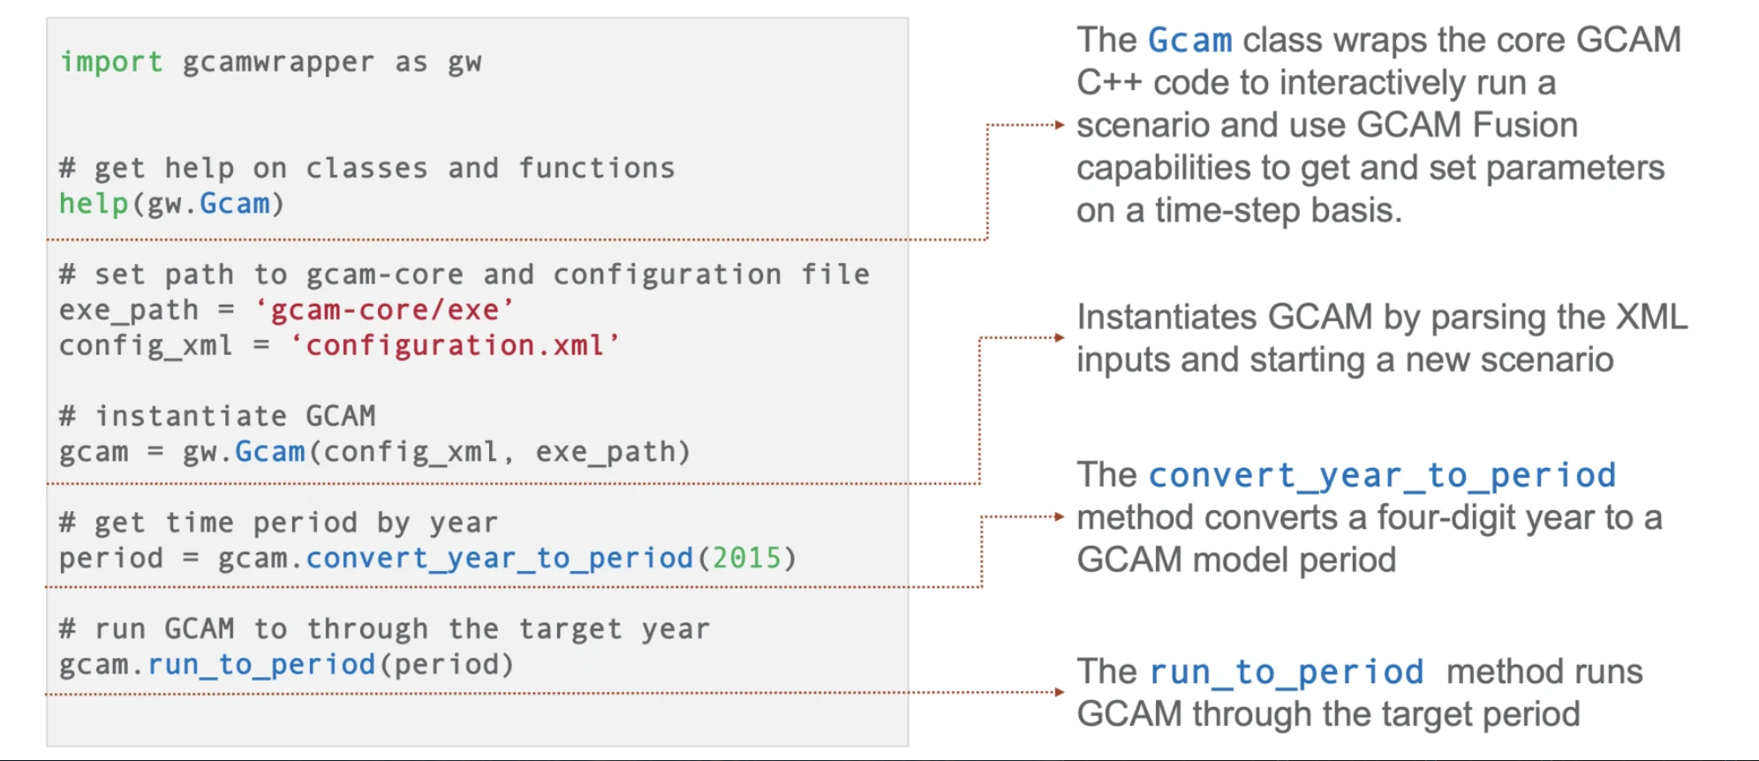
gcamwrapper: key functionality
CAPABILITY LEAD: Pralit Patel

Slide 35
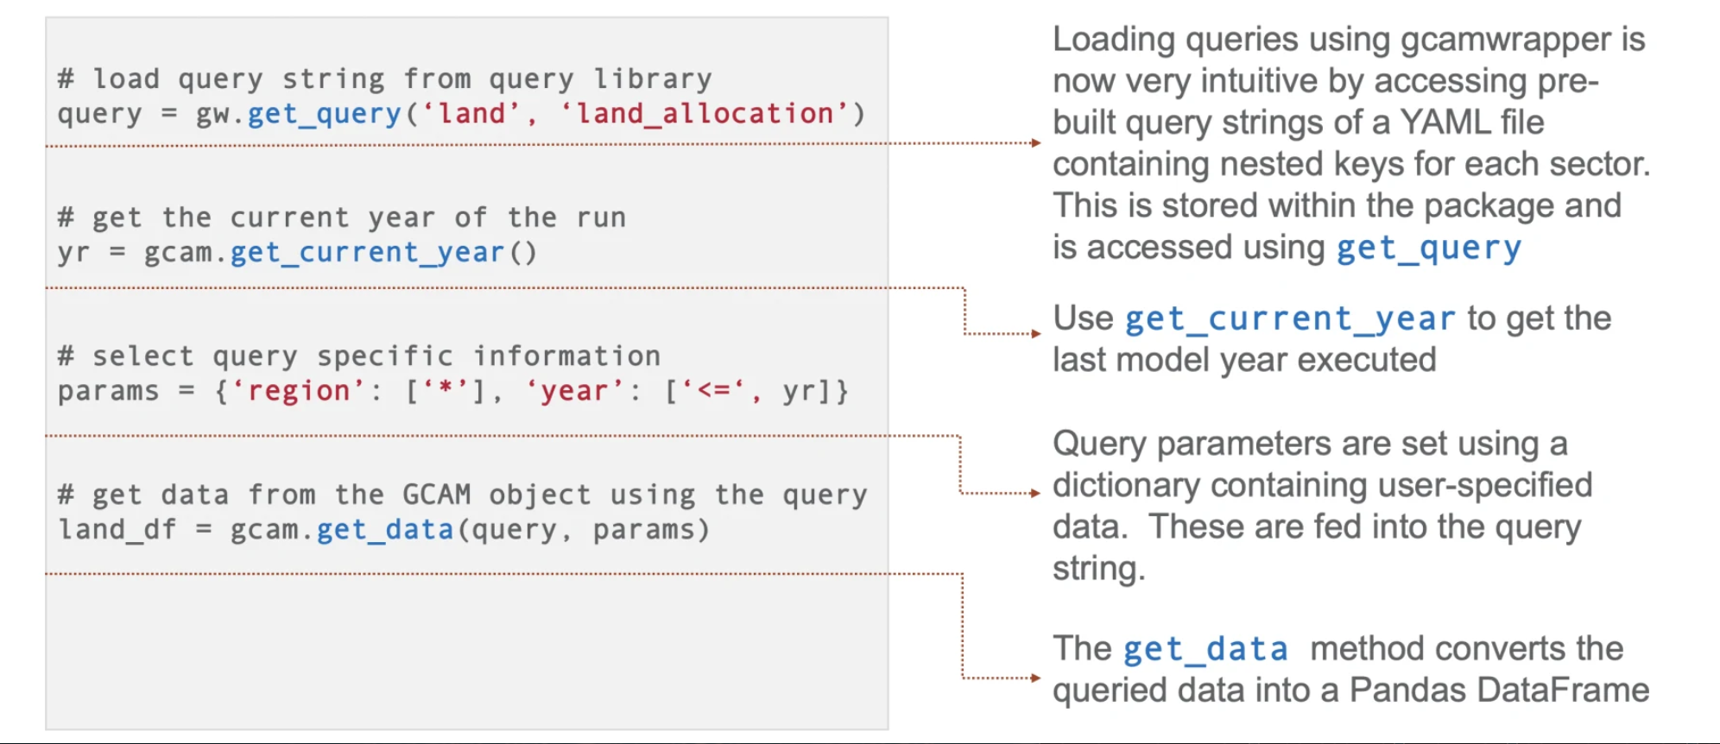
gcamwrapper: key functionality
CAPABILITY LEAD: Pralit Patel

Slide 36
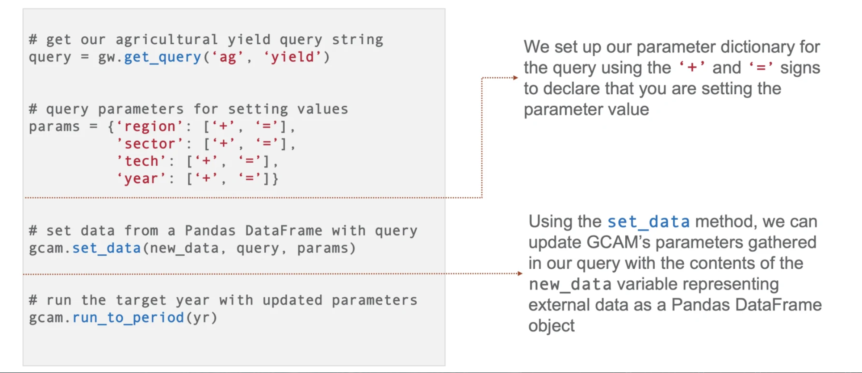
gcamwrapper: key functionality
CAPABILITY LEAD: Pralit Patel

Slide 37
gcamwrapper: specifics and demo
Can be found here: https://github.com/JGCRI/gcamwrapper
Does NOT contain GCAM
Need to link it against GCAM workspace
Instructions on how to set up found in README
R is not supported on Windows (for now)
Actively being developed to make it more streamlined

Slide 38
Thanks!

